Slide 1
NODE.JS
(The Backend Of MERN Stack)
Lecture 39

Slide 2
Today’s Agenda
Adding Validation In Mongoose
Validator Options
Custom Validators
Updating Documents
Deleting Documents
Examples

Slide 3
Adding validation in mongoose
Just like any framework, Mongoose also provides a way to validate data before we save that data to a database.
Data validation is important to make sure that “bad” data does not get persisted in our application.

Slide 4
Where to add validators ?
Mongoose’s validators are easy to configure.
When defining the schema, a developer can add extra options to the property that should be validated.
Validation is a middleware and Mongoose runs validation before saving the model into a database.

Slide 5
Validator options
Validator Property | Description
required | if we use this validation then the value of the property must exist
minlength | It is a number. It creates a validator that checks if the value length is not less than the given length.
maxlength | It is a number. It creates a validator that checks if the value length is not greater than the given length.
trim | this utility removes any leading or trailing whitespace in a value
default | this utility sets a default value for the property.
unique | It is a property but not a validator and it ensures that the value must be unique

Slide 6
Exercise 74
Write an Node-Mongoose application for saving and displaying records of employees with the following validations:
empName must be present.
empName must be atleast 5 characters in length.

Slide 7
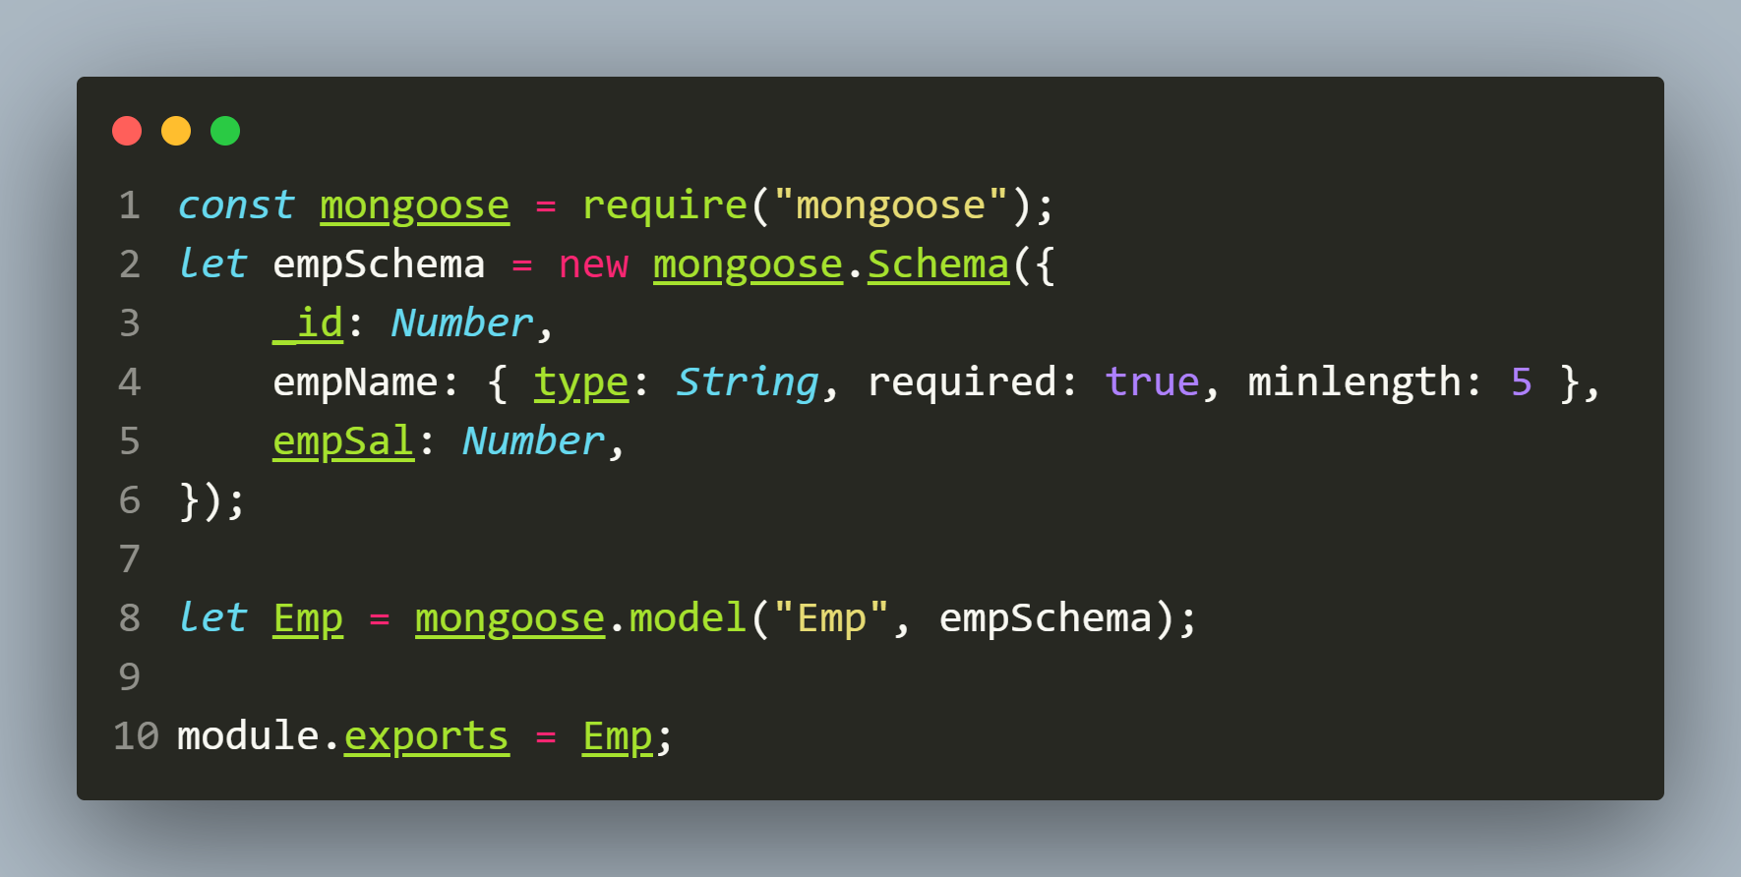
Solution(empModel.js)

Slide 8
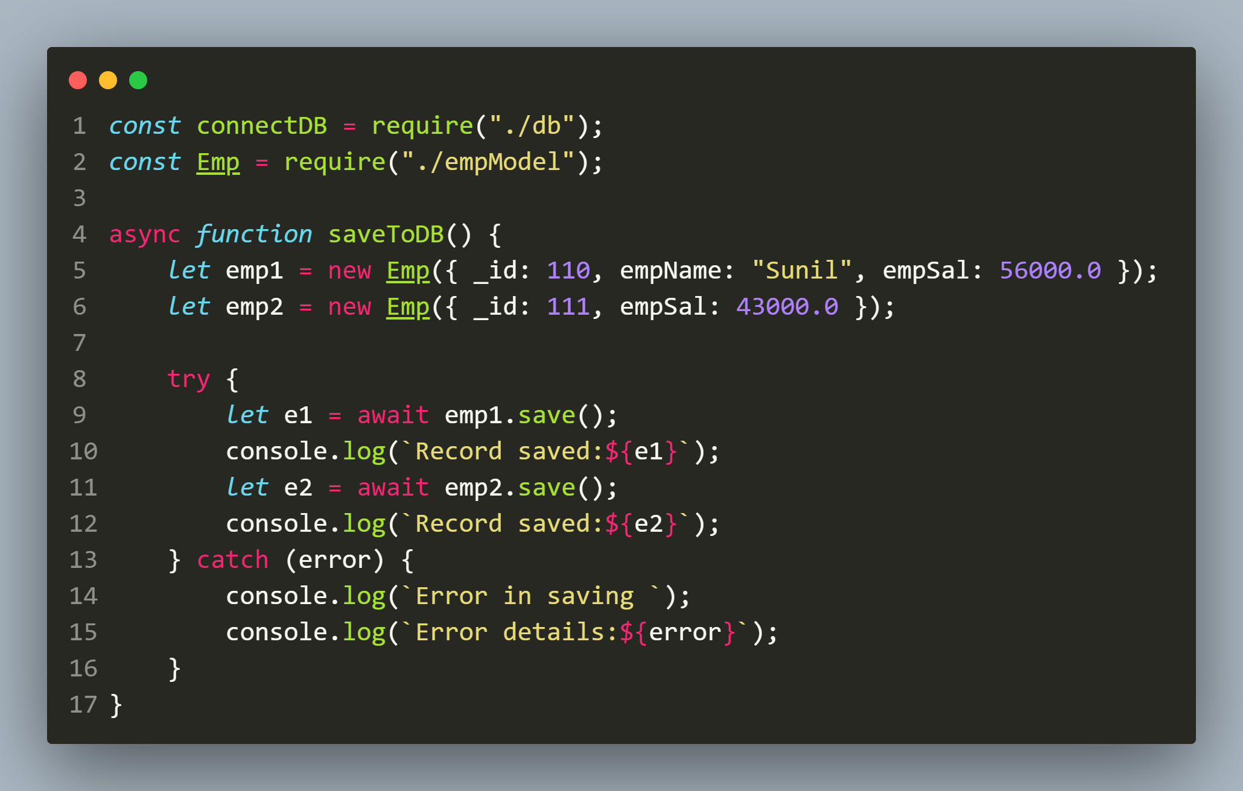
Solution(app.js)

Slide 9
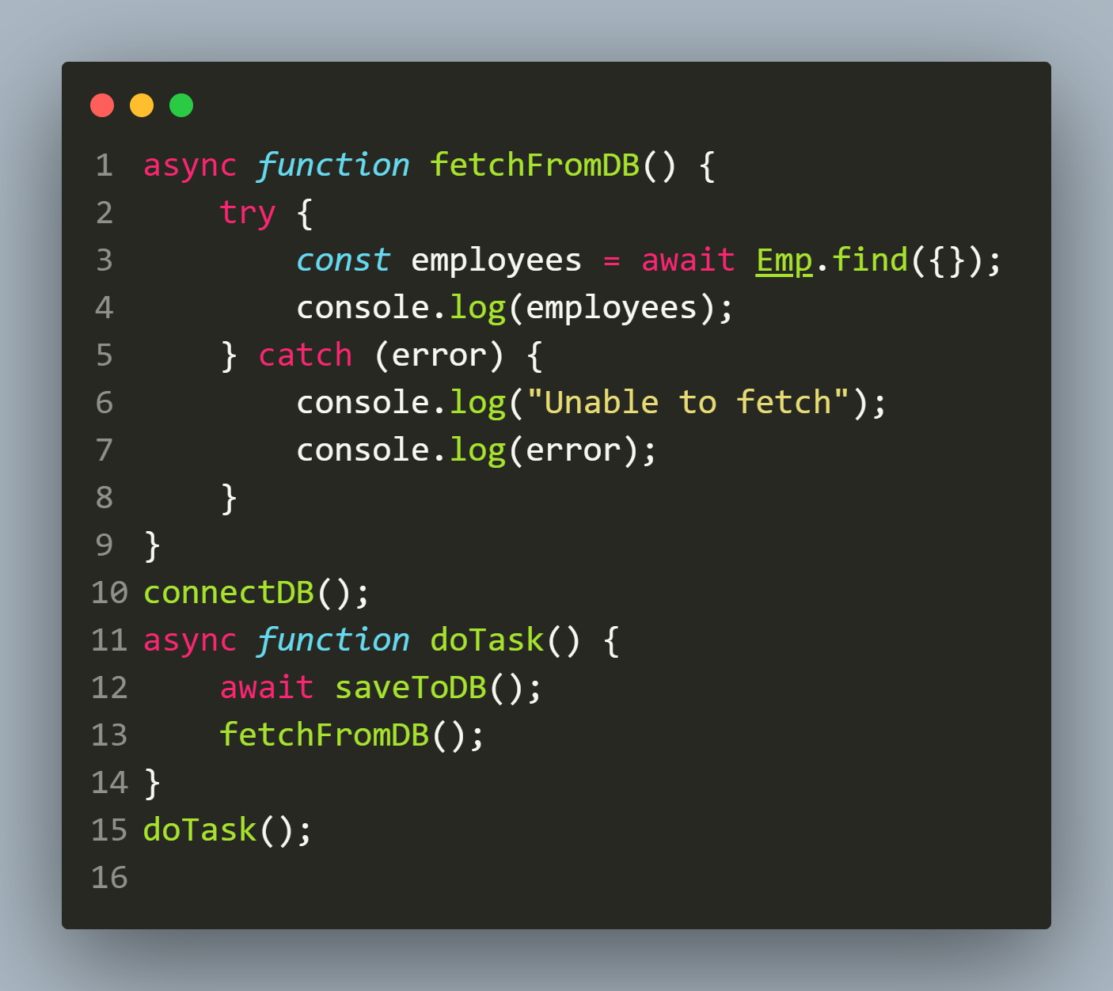
Solution(app.js)

Slide 10
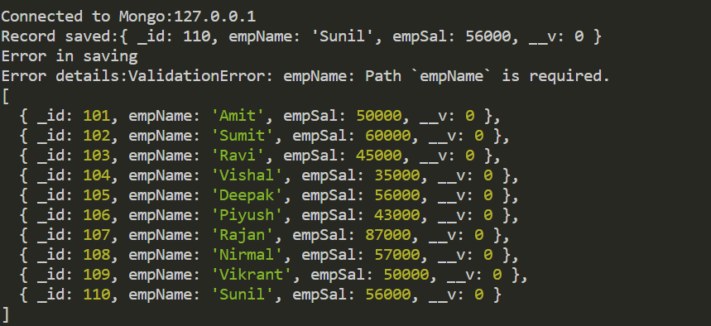
output

Slide 11
Custom validators
Custom validators are those which we define inside Schema object as per our requirement.
We have to use the validate keyword to create custom validations.
As its value, we will have an object that contains two keys called:
validator: This our custom function returning true or false
message: This is our error message

Slide 12
Custom validators
Syntax:
validate:{
validator: JS function body,
message: “Error message”
}

Slide 13
Exercise 75
Write an Node-Mongoose application for saving and displaying records of employees with the following validations:
empName must be present.
empName must be atleast 5 characters in length.
empSal must be between 40000 and 70000

Slide 14
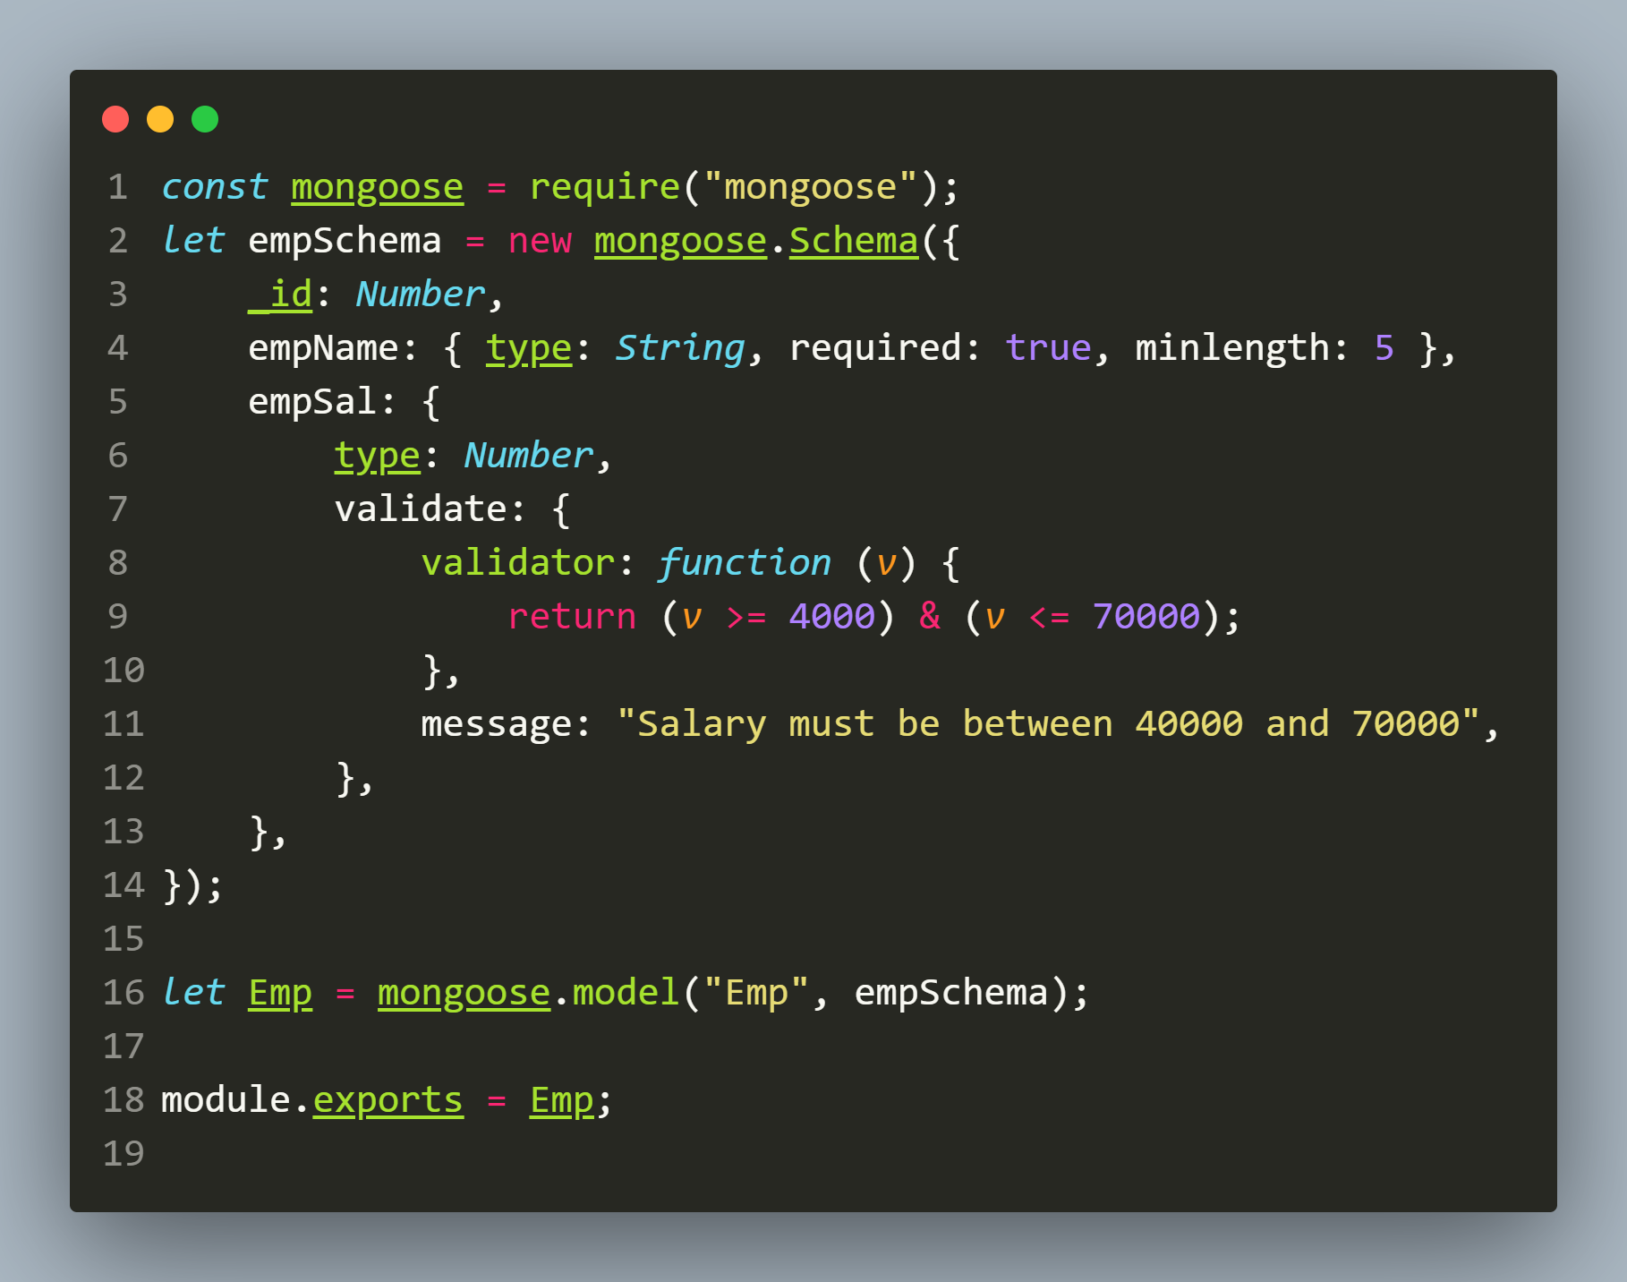
Solution(empModel.js)

Slide 15
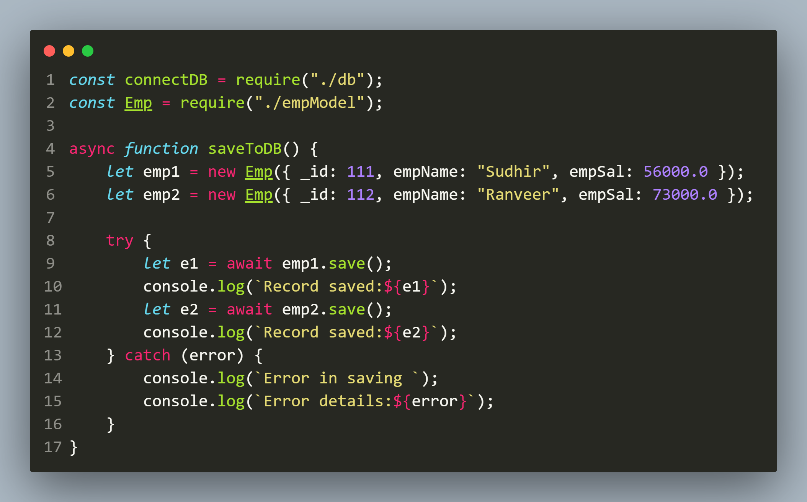
Solution(app.js)

Slide 16
Solution(app.js)

Slide 17
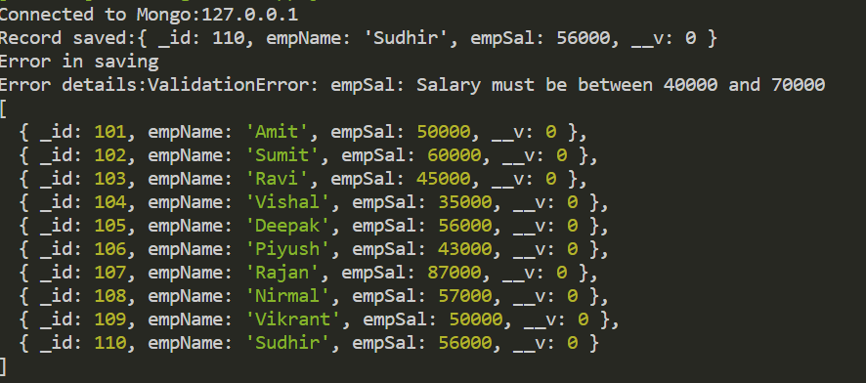
output

Slide 18
Updating documents
Mongoose provides different ways to update a document and they are:
save()
updateOne()
updateMany()
findOneAndUpdate()

Slide 19
Using save()
In this approach, we take 3 steps:
Find the document by it’s id first using findById().
Modify any properties we want to update.
Lastly make a call to the .save() method.

Slide 20
Exercise 76
Write an Node-Mongoose application to connect to the MongoDB database and update the salary of the emp with _id of 104 to 45000.

Slide 21
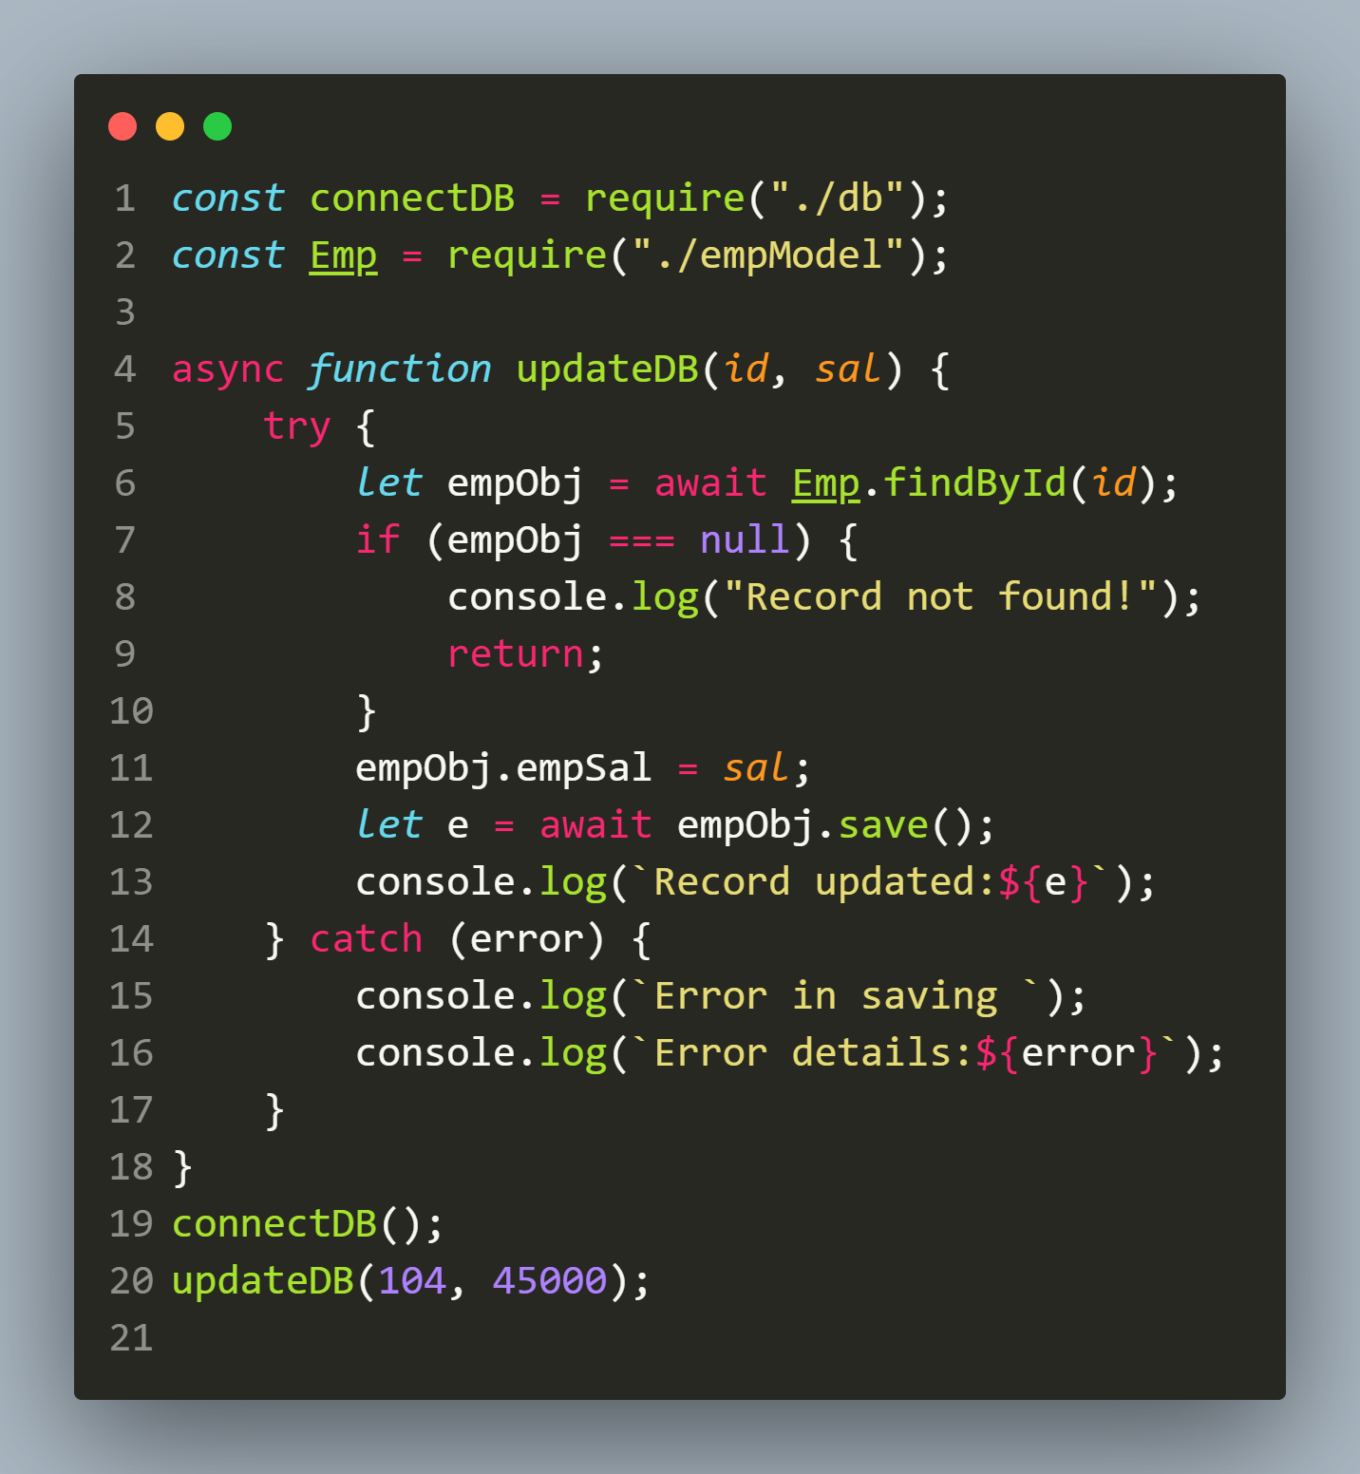
Solution(app.js)

Slide 22
output

Slide 23
Using updateOne()
The updateOne() method belongs to Model constructor and is used to update one document according to the condition without loading it from the database first.
Syntax:
Model.updateOne({filter},{update},{options})
filter: Represents the filter object . MongoDB will search for first document that matches the filter.
update: A object representing field:value to be updated
options: An object representing query options

Slide 24
What does updateOne() return ?
The method updateOne() returns an JS object containing properties like acknowledged, modifiedCount, matchedCount etc indicating the status of update operation.

Slide 25
Exercise 77
Write an Node-Mongoose application to connect to the MongoDB database and update the salary as well as name of the emp with _id of103 to Rakesh and 54000 respectively.
Also display whether updation was successful or not.

Slide 26
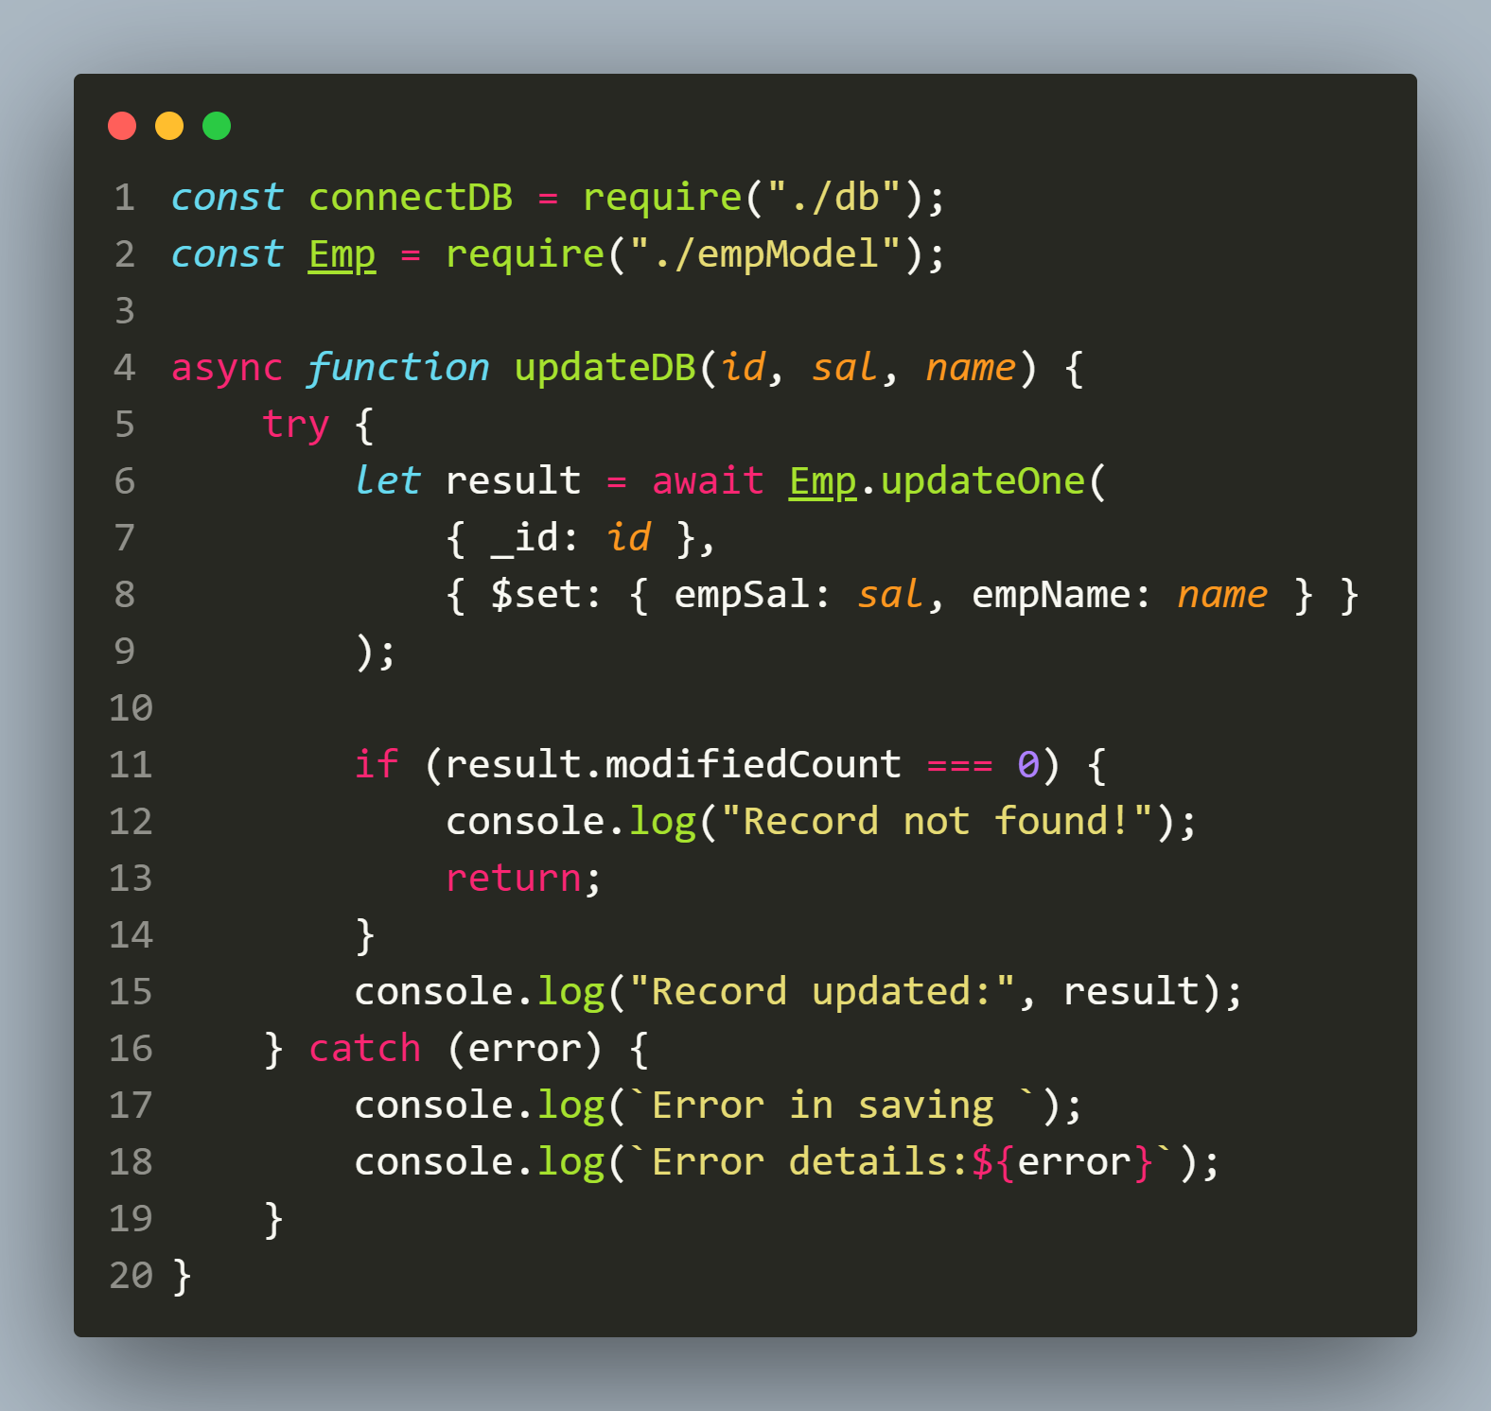
Solution(app.js)

Slide 27
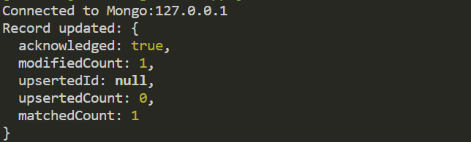
output

Slide 28
Using updateMany()
The updateMany() method also belongs to Model constructor and is used to update multiple document according to the condition.
Syntax:
Model.updateMany({filter},{update},{options})
filter: Represents the filter object . MongoDB will search for all documents that matches the filter.
update: A object representing field:value to be updated
options: An object representing query options

Slide 29
What does updateMany() return ?
Similar to the method updateOne() , the method updateMany() also returns an JS object containing properties like acknowledged, modifiedCount, matchedCount etc indicating the status of update operation.

Slide 30
Exercise 78
Write an Node-Mongoose application to connect to the MongoDB database and increment the salary by Rs 2000 of all the employees with _id greater than 105
Also display whether updation was successful or not and if successful then how many employees were updated.

Slide 31
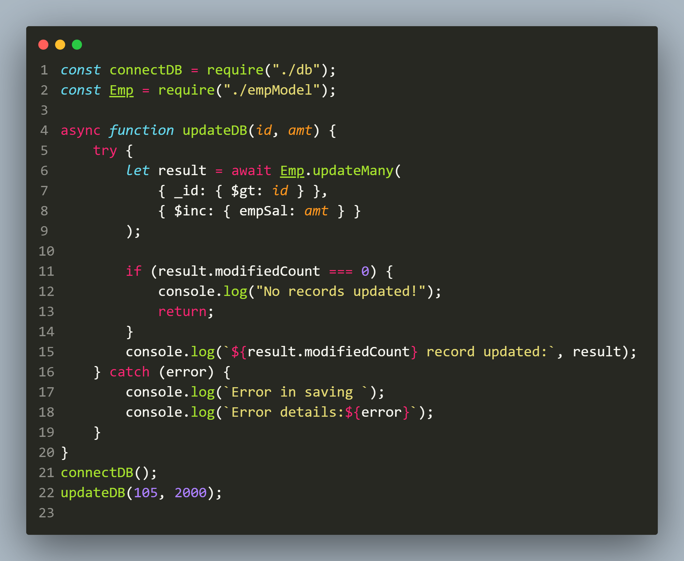
Solution(app.js)

Slide 32
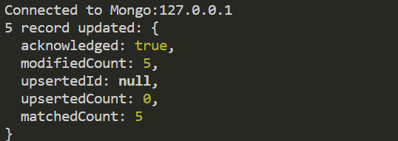
output

Slide 33
Using findOneAndUpdate()
The method findOneAndUpdate() as well as its variation findByIdAndUpdate() also behave same as updateOne().
That is , it atomically updates the first document that matches the first parameter filter.
However unlike updateOne(), it gives us back the updated document.

Slide 34
Using findOneAndUpdate()
Syntax:
Model.findOneAndUpdate({filter},{update},{options})
filter: Represents the filter object . MongoDB will search for all documents that matches the filter.
update: A object representing field:value to be updated
options: An object representing query options

Slide 35
Exercise 79
Write an Node-Mongoose application to connect to the MongoDB database and increment the salary by Rs 3000 of the first employee with current salary of 45000
Also display whether updation was successful or not.

Slide 36
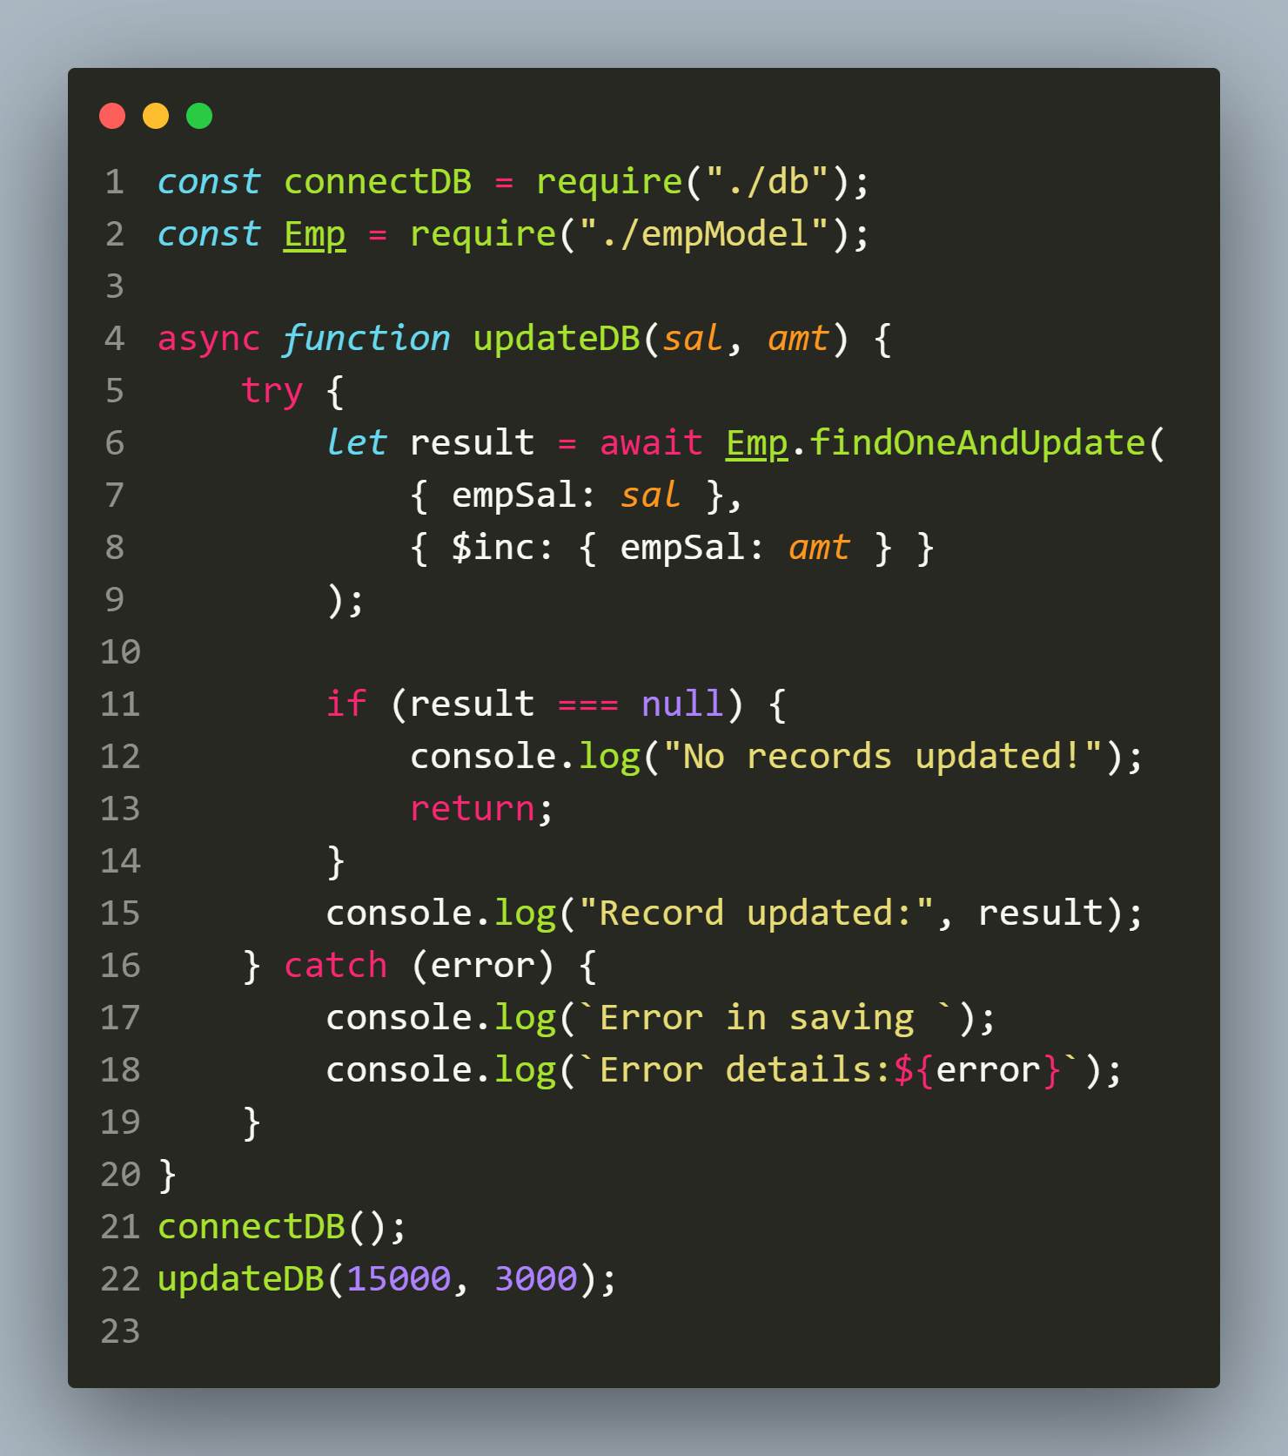
Solution(app.js)

Slide 37
output
Why we got the old record and not the updated record even though the document was updated ?
That’s because by default findOneAndUpdate() returns the original document .
To get the updated document we need to set the option new:true

Slide 38
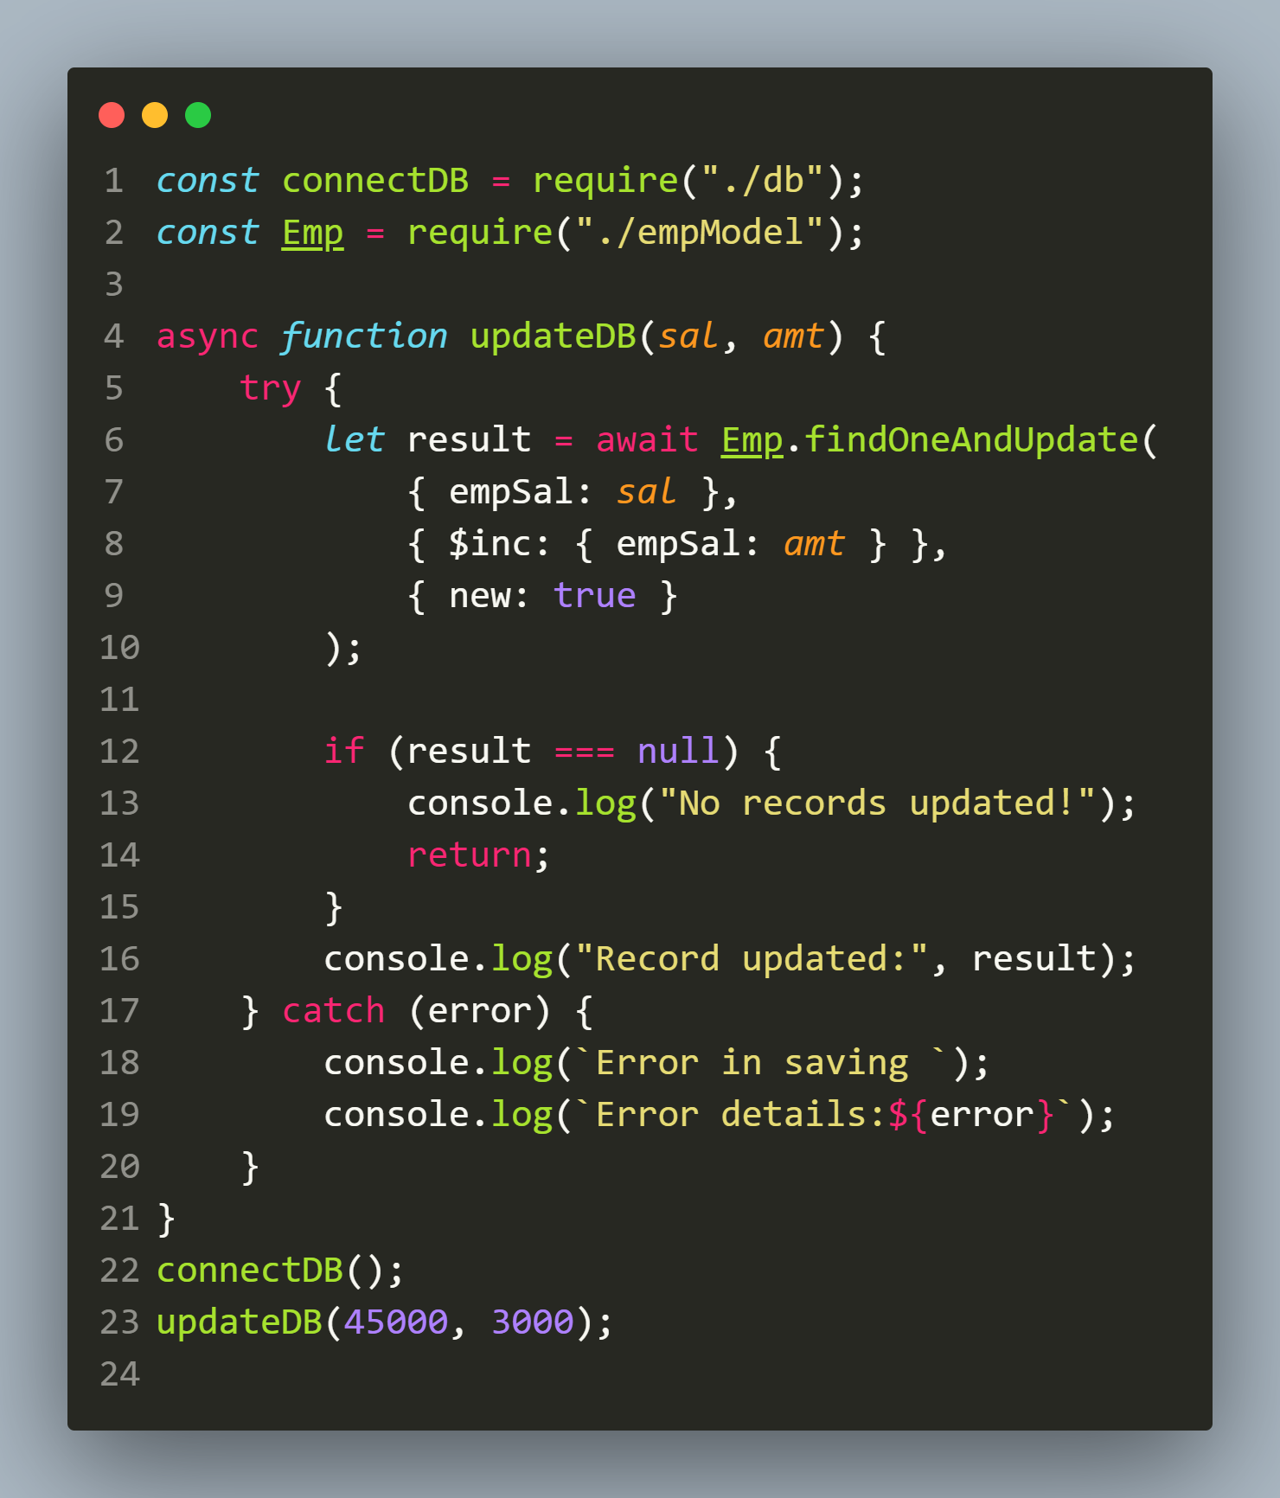
Setting new:true

Slide 39
output

Slide 40
deleting documents
Like update ,for delete also Mongoose provides us different ways and they are:
deleteOne()
deleteMany()
findOneAndDelete()

Slide 41
Using deleteOne()
The deleteOne() method belongs to Model constructor and is used to delete one document according to the condition.
Syntax:
Model.deleteOne({filter},{options})
filter: Represents the filter object . MongoDB will search for first document that matches the filter.
options: An object representing query options

Slide 42
What does deleteOne() return ?
The method deleteOne() returns an object with the property called deletedCount indicating how many documents were deleted.

Slide 43
Exercise 80
Write an Node-Mongoose application to connect to the MongoDB database and delete the the emp with _id of 110
Also display whether deletion was successful or not.

Slide 44
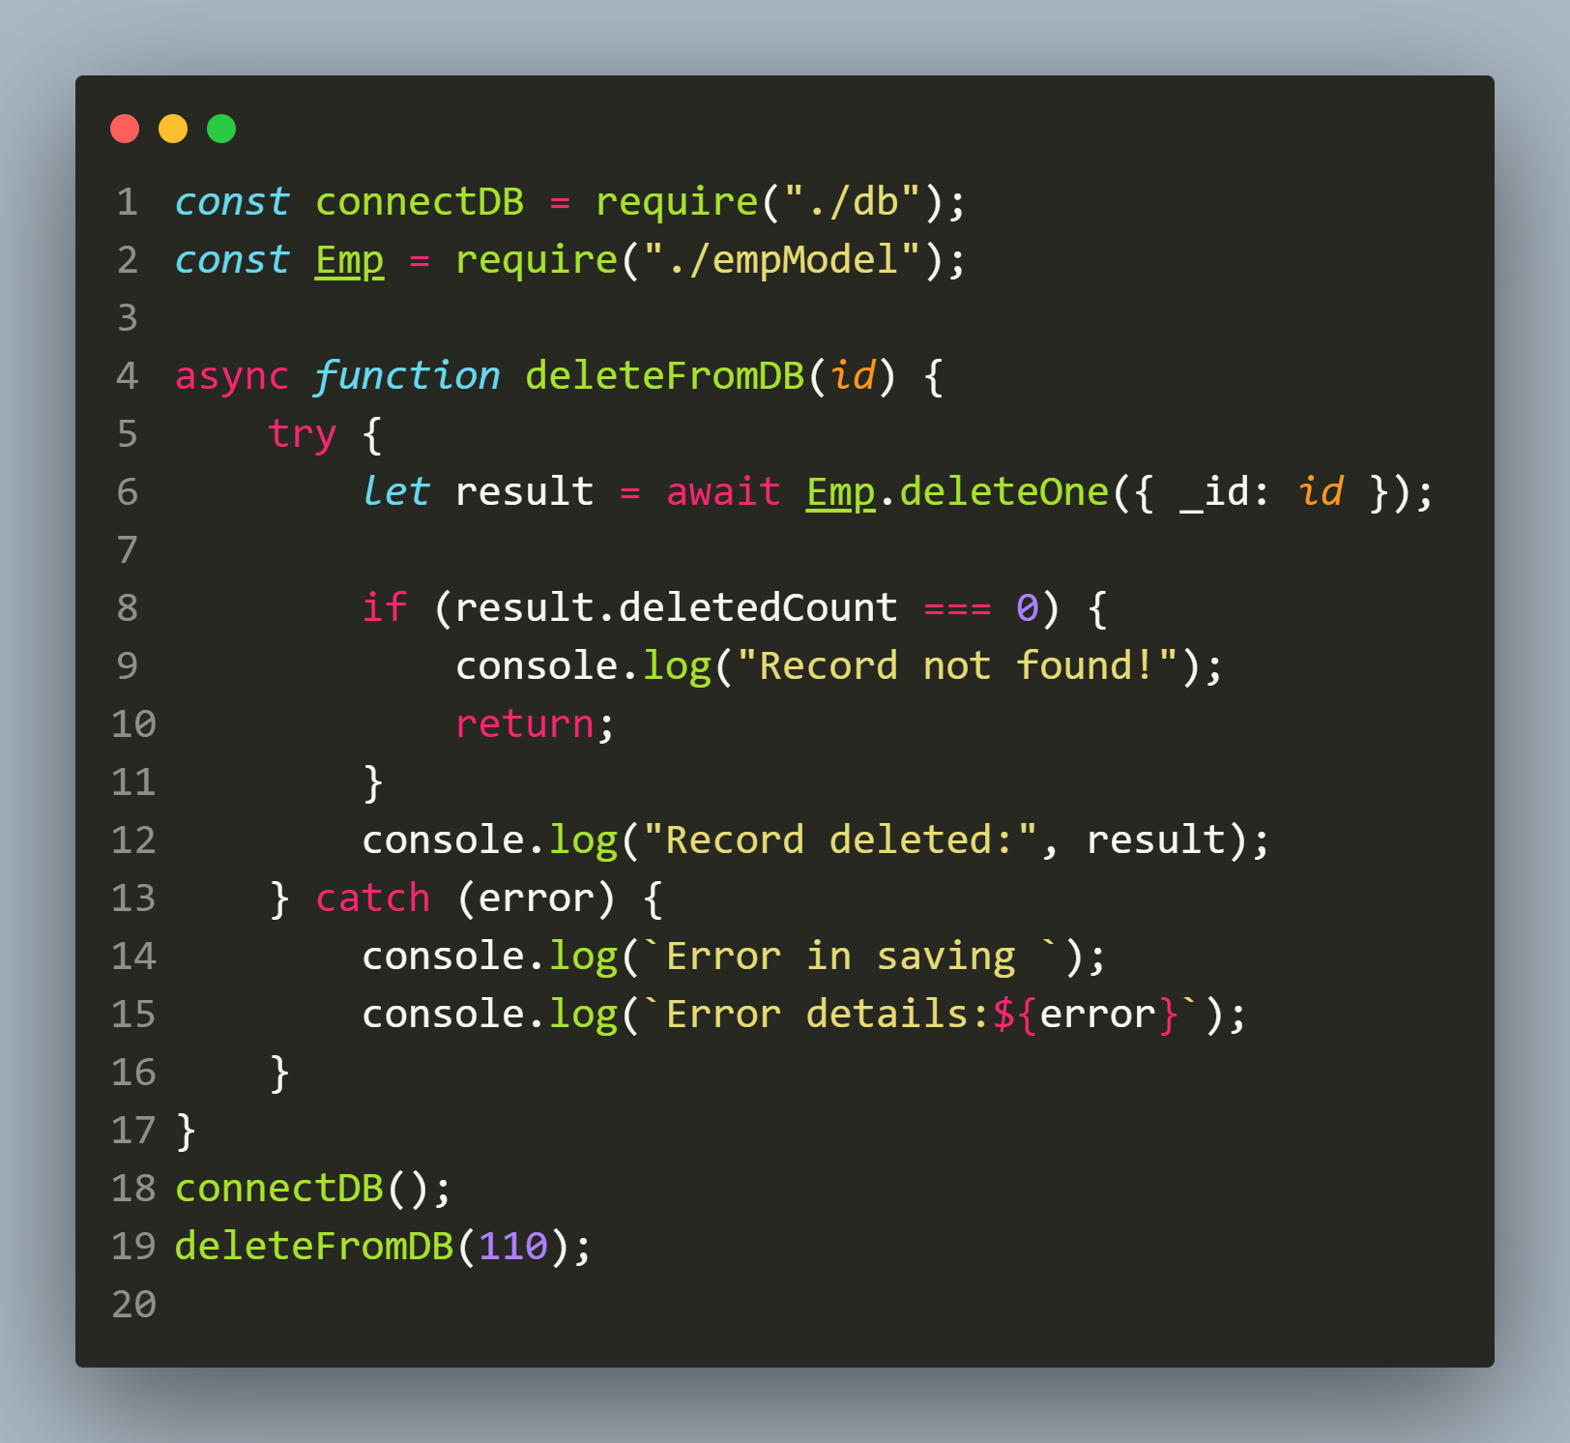
Solution(app.js)

Slide 45
output

Slide 46
Using deleteMany()
The deleteMany() method also belongs to Model constructor and is used to delete multiple document according to the condition.
Syntax:
Model.deleteMany({filter},{options})
filter: Represents the filter object . MongoDB will search for all documents that matches the filter.
options: An object representing query options

Slide 47
What does deleteMany() return ?
Similar to the method deleteOne() , the method deleteMany() also returns an object with the property called deletedCount indicating how many documents were deleted.

Slide 48
Exercise 81
Write an Node-Mongoose application to connect to the MongoDB database and delete the records of all the employees with salary greater than 50000
Also display whether deletion was successful or not and if successful then how many records were deleted.

Slide 49
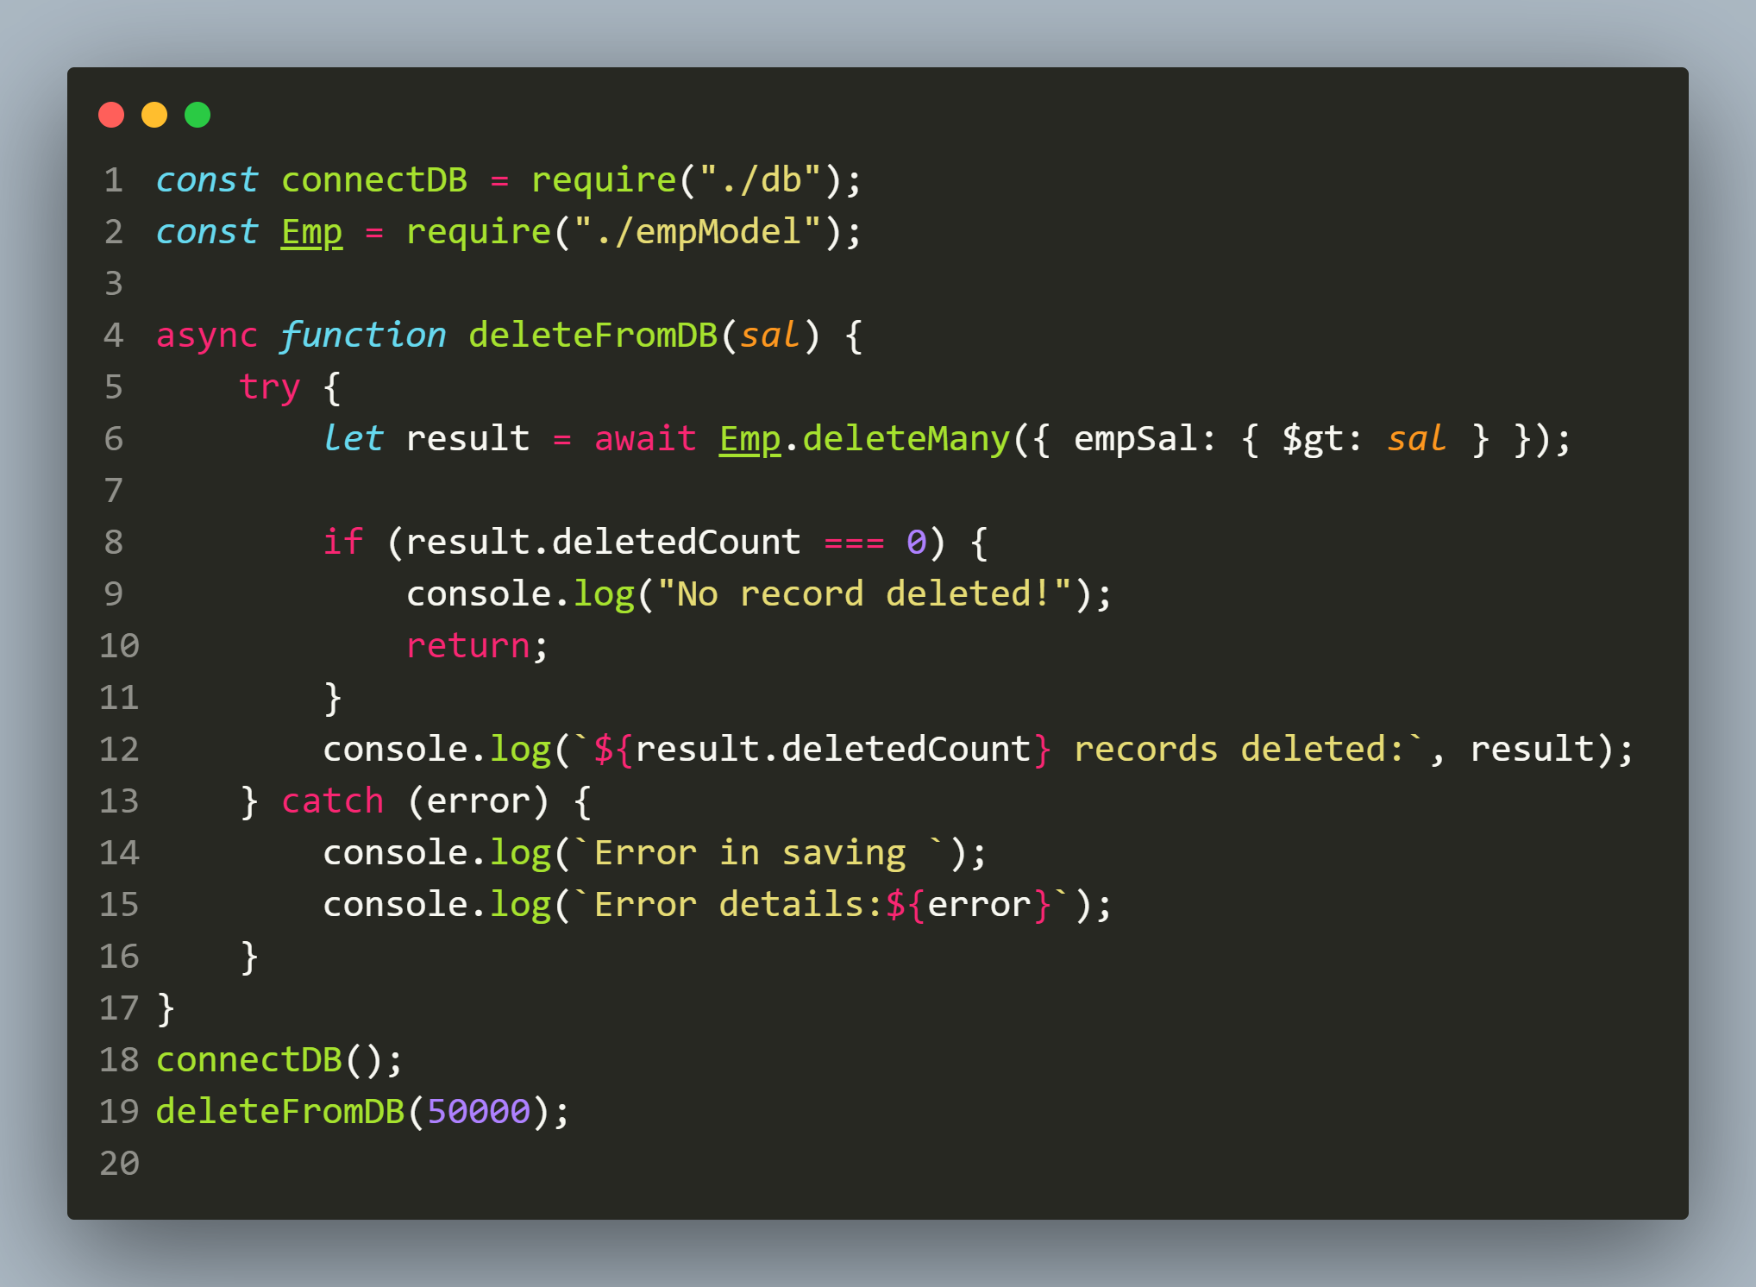
Solution(app.js)

Slide 50
output

Slide 51
Using findOneAndDelete()
The method findOneAndDelete() as well as its variation findByIdAndDelete() also behave same as deleteOne().
That is , it the first document that matches the first parameter filter.
However unlike deleteOne(), it gives us back the deleted document.

Slide 52
Using findOneAndDelete()
Syntax:
Model.findOneAndDelete({filter},{options})
filter: Represents the filter object . MongoDB will search for all documents that matches the filter.
options: An object representing query options

Slide 53
Exercise 82
Write an Node-Mongoose application to connect to the MongoDB database and delete the record of the employee named ‘Piyush’.
Also display whether deletion was successful or not.

Slide 54
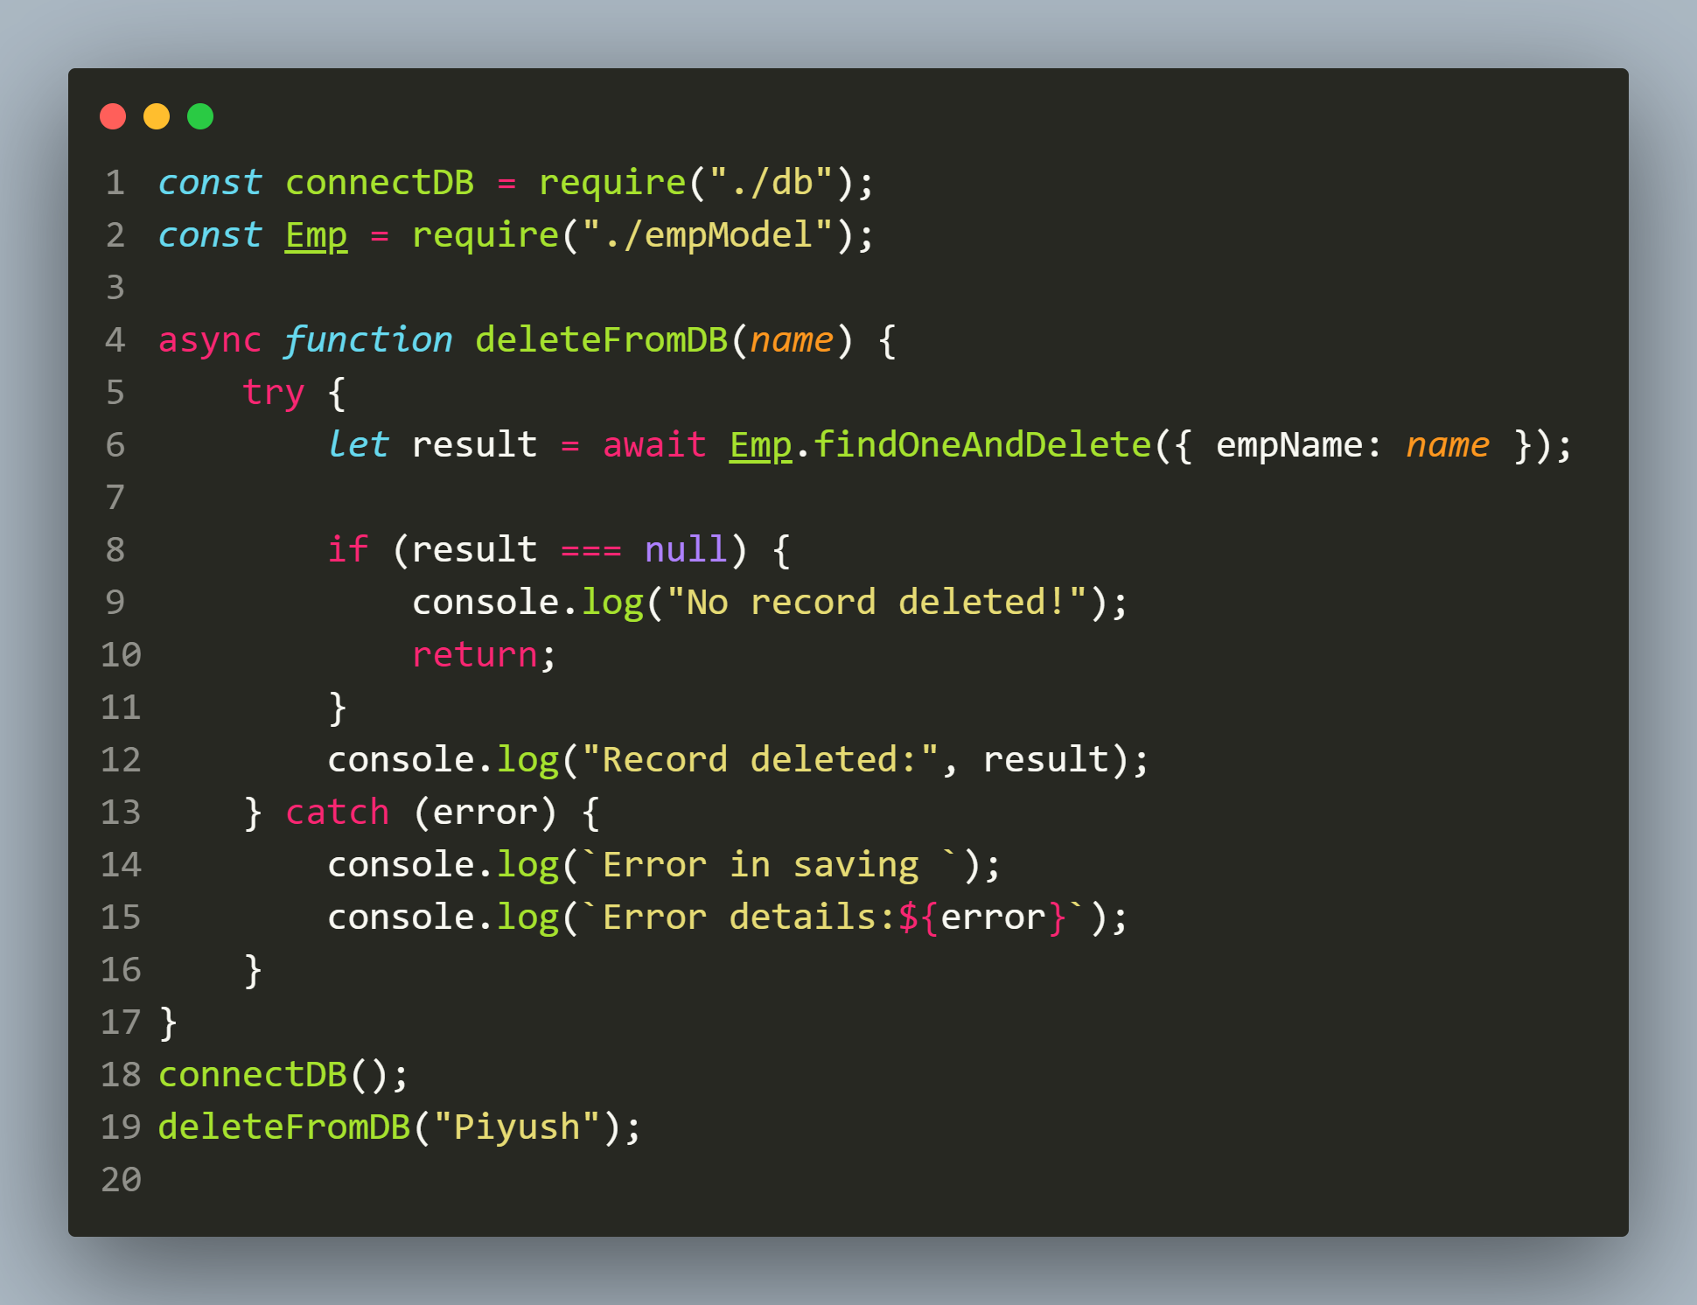
Solution(app.js)

Slide 55
output

